Slide 1

NBA Data Analysis
DETAILED PROJECT REPORT

Slide 2
Project details:
Project Title | NBA Teams & Player Performance Analysis
Technologies | Business Intelligence
Domain | Sports Analysis
Difficulties level | Intermediate

Slide 3
Objective: The objective of the project is to perform data visualization to understand the insight of the data. This project aims apply various Business Intelligence tools such as Tableau or Power BI to get a visual understanding of the data and helps in getting the clear insights from the data.

Slide 4
Problem Statement:
The data given consists of the NBA teams and players for the different seasons and drafts from they picked by a team. The object is to analyze the performance of the teams and players for the season and match they played.

Slide 5
Dataset information: The Dataset contains the teams details and player details and the countries they represent.
The draft data for different years and how many rounds happened in that year and players picked from that draft.

Slide 6

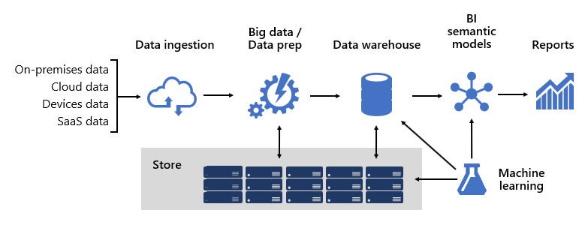
ARCHITECTURE

Slide 7
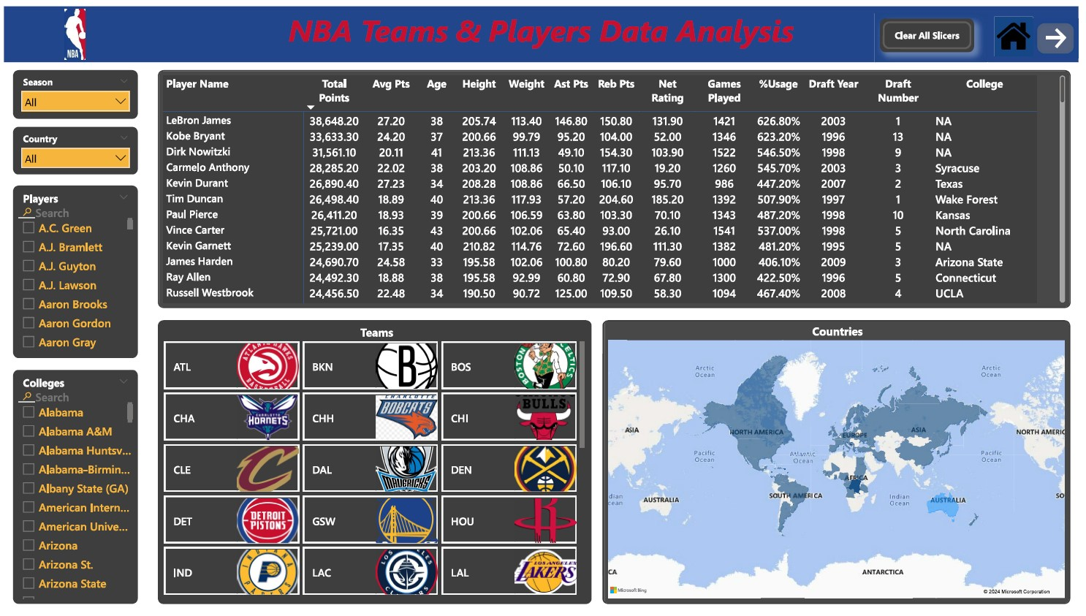

Slide 8
QUESTIONS:
Q1) What’s the source of data?
The dataset is taken from Kaggle
Q2) What was the type of data?
The data was the combination of numerical and Categorical values.

Slide 9
Q 3) What techniques were you using for data pre-processing?
Removing unwanted attributes
Visualizing relation of independent variables with each other and output variables
Removing outliers
Cleaning data and imputing if null values are present.

Slide 10
Thank you

